Slide 1
GIT

Slide 2
Introduction of Version Control Systems
Version control also known as Revision control a.k.a. source control, is a process to manage a collection of program code and changes which provides you with many capabilities, such as:
Maintain multiple versions of code
An ability to go back to any previous version.
Developers can work in parallel.
Audit traceability with clear picture on whom, which when, where and what are the changes.

Slide 3
Synchronize the code.
Copy/Merge/Undo the changes.
Find out the difference between versions.
Provides full backup without occupying much space.
Review the history of the change.
Capable for both small and large scale projects.
Ability to share and work on the code across the globe.

Slide 4
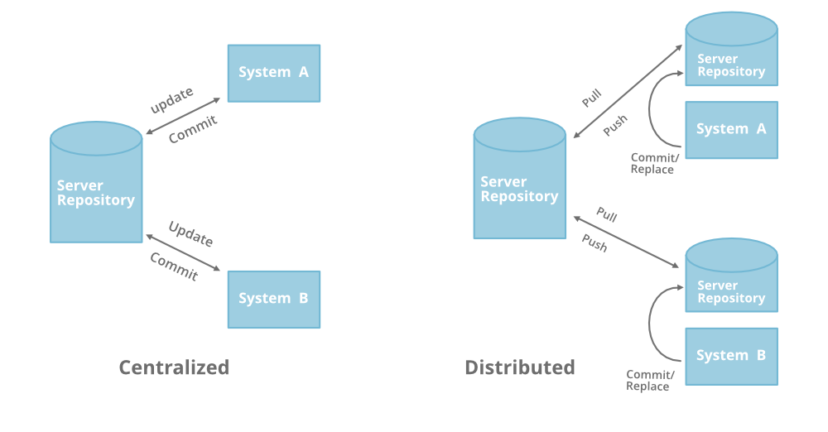
DVCS vs CVCS

Slide 5
GIT
Git is a free and open source distributed version control system designed to handle everything from small to very large projects with speed and efficiency.
git: an open source, distributed version-control system
GitHub: a platform for hosting and collaborating on Git repositories
commit: a Git object, a snapshot of your entire repository compressed into a SHA
branch: a lightweight movable pointer to a commit
clone: a local version of a repository, including all commits and branches

Slide 6
remote: a common repository on GitHub that all team members use to exchange their changes
fork: a copy of a repository on GitHub owned by a different user
pull request: a place to compare and discuss the differences introduced on a branch with reviews, comments, integrated tests, and more
HEAD: representing your current working directory, the HEAD pointer can be moved to different branches, tags, or commits when using git checkout

Slide 7
GIT Commands
git init
git clone
git config user.name paritosh.puri
git config user.email "paritosh.puri@e2enetworks.com"

Slide 8
git status
git add
git commit -m
git log [--oneline, --stat, -2, --graph --decorate]
git commit --amend
git reflog --relative-date
git stash
git stash apply
git stash list
git stash pop

Slide 9
git branch
git checkout
git merge
git fetch
git pull
git push

Slide 10
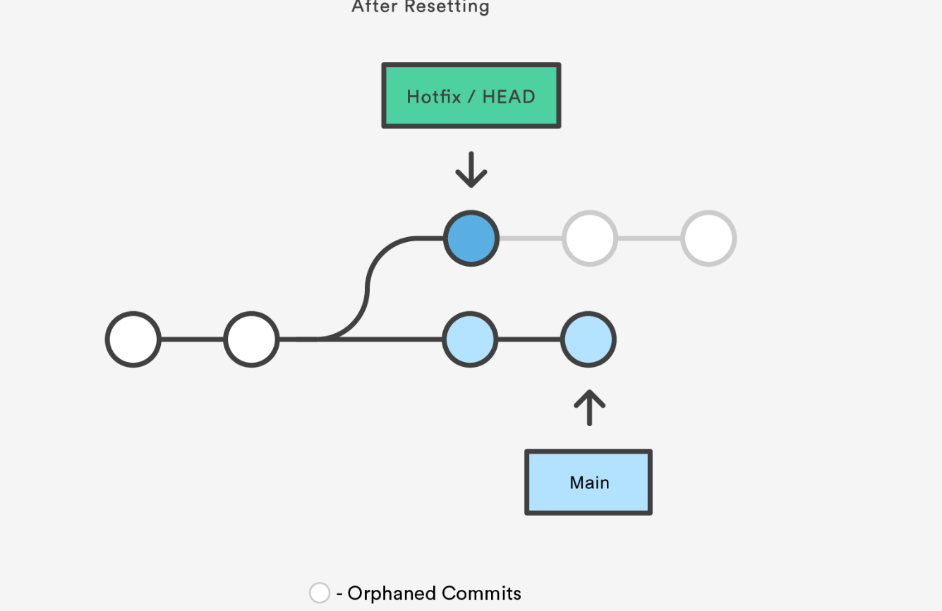
Advance git commands
git rebase
git reset HEAD~2

Slide 11
git merge --squash
git cherry-pick
git blame
git shortlog [--grep paritosh]
git whatchanged

Slide 12
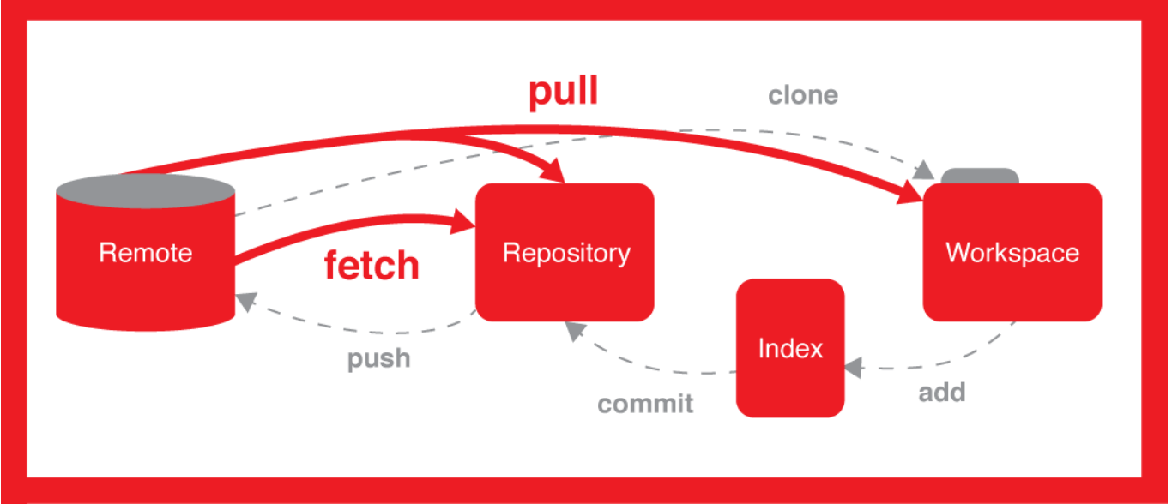

Slide 13
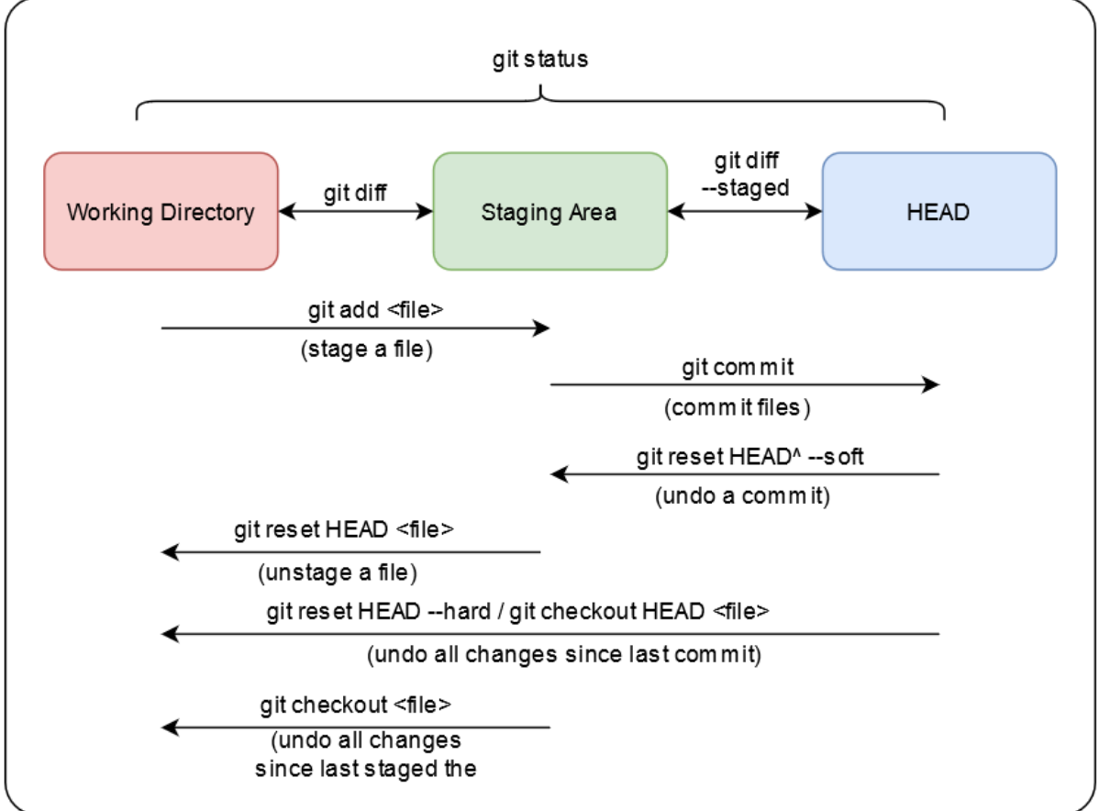

Slide 14
Thank You
Paritosh Puri
E2E Networks

